Slide 1
HYBRIS: Security week 7
Task 7.4 (Security):
This task depends on Hybris Commerce functionality. Before doing this task, you need to install Hybris Merchandise Store (https://wiki.hybris.com/display/R5T/Shortcut+to+the+Merchandise+Store).
Select any page from the Merchandise Store. Disable this page for anonymous users.

Slide 2
The page I chose is the store finder page. I’m making it disabled for anonymous users which means only those users can see it who are authenticated and logged in.
Note

Slide 3
I can change the spring-security.xml file like this: <security:http disable-url-rewriting="true" request-matcher-ref="excludeUrlRequestMatcher" use-expressions="true"> <security:anonymous username="anonymous" granted-authority="ROLE_ANONYMOUS" /> … <security:intercept-url pattern="/store-finder" access="!hasRole('ROLE_ANONYMOUS')" /> … </security:http> Once an anonymous user hits the URL they are getting redirected to the login page.
Step

Slide 4
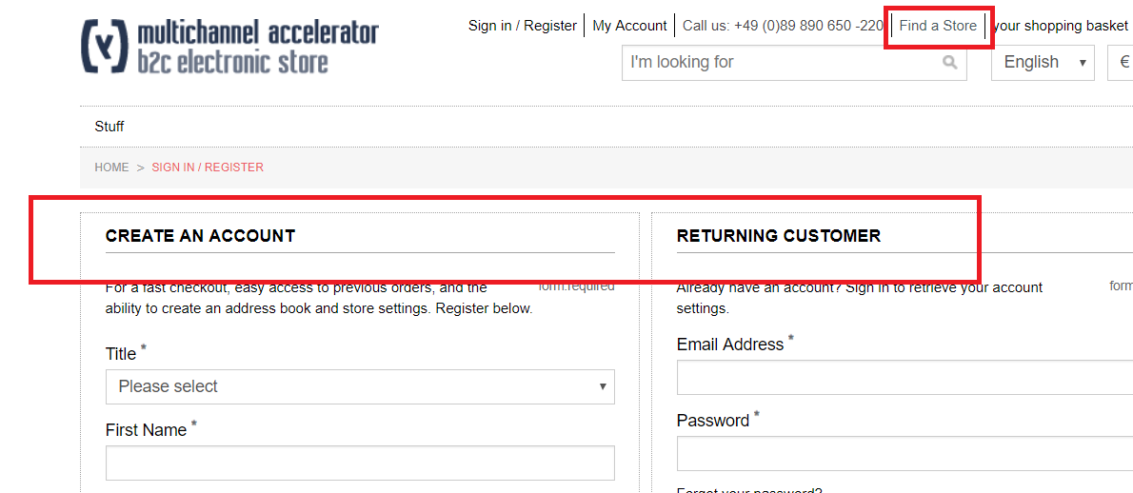
Screenshot

